Slide 1
HUB floating point on FPGA (Field Programmable Gate Array)
GROUP MEMBERS: Ruchi Dhamnani
Ananya Garg
Parul Damahe
Purvi Agrawal
GROUP MENTOR: Dr. Shrivishal Tripathi

Slide 2

Outline:
Introduction
Objective
Motivation
Literature Survey
Proposed Solution
Result
Acknowledgement
References

Slide 3

Introduction:
Floating Point (FP) multiplication is widely used in large set of scientific and signal processing computation.
Floating point numbers are represented in the form of binary format.
For this reason, FP arithmetic is being introduced on field-programmable gate array (FPGA) implementations
The advantage of floating-point representation over fixed-point and integer representation is that it can support a much wider range of values.
.

Slide 4
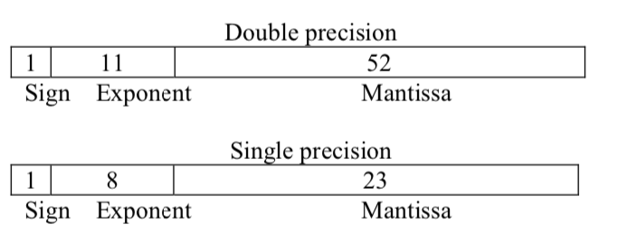
BINARY REPRESENTATION FORMAT
It consists of a one bit sign (S), an eight bit exponent (E), and a twenty three bit fraction (M or Mantissa). An extra bit is added to the fraction to form the significand.

Slide 5
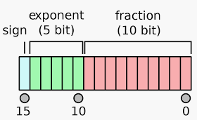
IEEE HALF PRECISION BINARY FLOATING POINT FORMAT:
The IEEE 754 standard specifies a binary16 as having the following format:
Sign bit: 1 bit
Exponent width: 5 bits
Significand precision: 11 bits (10 explicitly stored)

Slide 6
Objective :
Multiplication is one of the common arithmetic operations in these computations.
The need of high speed multiplier is increasing as the need of high speed processors are increasing.
Higher throughput arithmetic operations are important to achieve the desired performance in many real time signal and image processing applications.

Slide 7

Contd..
One of the key arithmetic operations in such applications is multiplication and the development of fast multiplier circuit has been a subject of interest over decades.
Also reducing the time delay and power consumption are very essential requirements for many applications.

Slide 8
Motivation...
Why Half-unit Biased FP Multipliers and adder?
Half unit biased technique is very much useful for improving efficiency and reducing energy consumption.
We will be using different adders and multipliers for this purpose and comparing their energy consumption and accuracy. And we have implemented it on Field Programmable Gate Array (FPGA) and ZEDBoard.
In order to become the 1% you must do what the other 99% won’t !!!

Slide 9
 | Title | Link | Year | Advantage | Disadvantage
1) | A Two's Complement Parallel Array Multiplication algorithm | https://ieeexplore.ieee.org/document/1672241 | 1974 | Every partial product bit has a positive coefficient. | Need for the complements of each multiplier and multiplicand
2) | HUB Floating Point for Improving FPGA Implementations of DSP Applications | https://ieeexplore.ieee.org/stamp/stamp.jsp?tp=&arnumber=7465754 | 2012 | Conservative power savings of up to 15% | Architecture fabricated on the TSMC 90 nm process area consumption is more
3) | Area efficient multipliers for Digital Signal Processing Application | https://ieeexplore.ieee. org/stamp/stamp.jsp?arnumber=4864 55 | 1996 | Area consumption is reduced to 50% | Due to truncation accuracy is reduced
4) | Design of Reconfigurable Low-Power Pipelined Array Multiplier | https://ieeexplore.ieee.org/document/4064379 | 2006 | Low Power Consumption | Delay overhead
5) | Real-time Fall Detection Algorithm with a Prog. Truncated MAC | https://ieeexplore.ieee.org/iel5/5608545/5625939/05626244.pdf | 2010 | 23% power savings without any accuracy loss. | Truncation of low bits of columns result in robust gap values

Slide 10
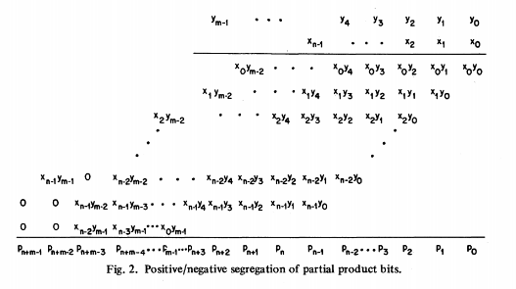
Contd..
A Two's Complement Parallel Array Multiplication Algorithm:
In this method the signs of all the partial product bits are positive.
The product is formed by adding the first n - 2 partial product rows and subtracting the last two rows. Instead of subtracting the partial products that have negative signs, the negation of the partial products can be added.

Slide 11
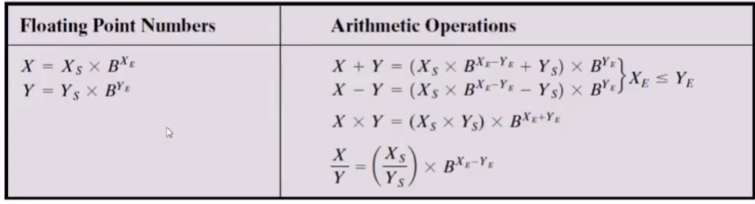
Floating Point operations:
Floating point adder units like fused floating point adder, triple path floating point adder, etc.., involve exponent comparison/subtraction, mantissa addition/subtraction and incrementing values while rounding, as basic operations. To realize these operations, efficient arithmetic units like comparators, adders, subtractors, incrementers are vital.

Slide 12
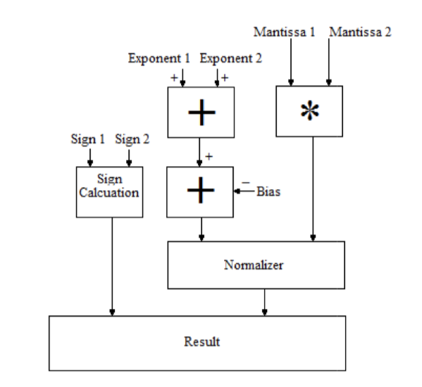
Proposed Solution:
To perform a FP multiplication following steps are to be done:
Step 1 :
The mantissa parts of two FP numbers are multiplied and the result is normalized.
Step 2:
The exponents of two FP numbers are added.
Step 3:
These are the exponent and mantissa parts of the final resulting FP number.

Slide 13
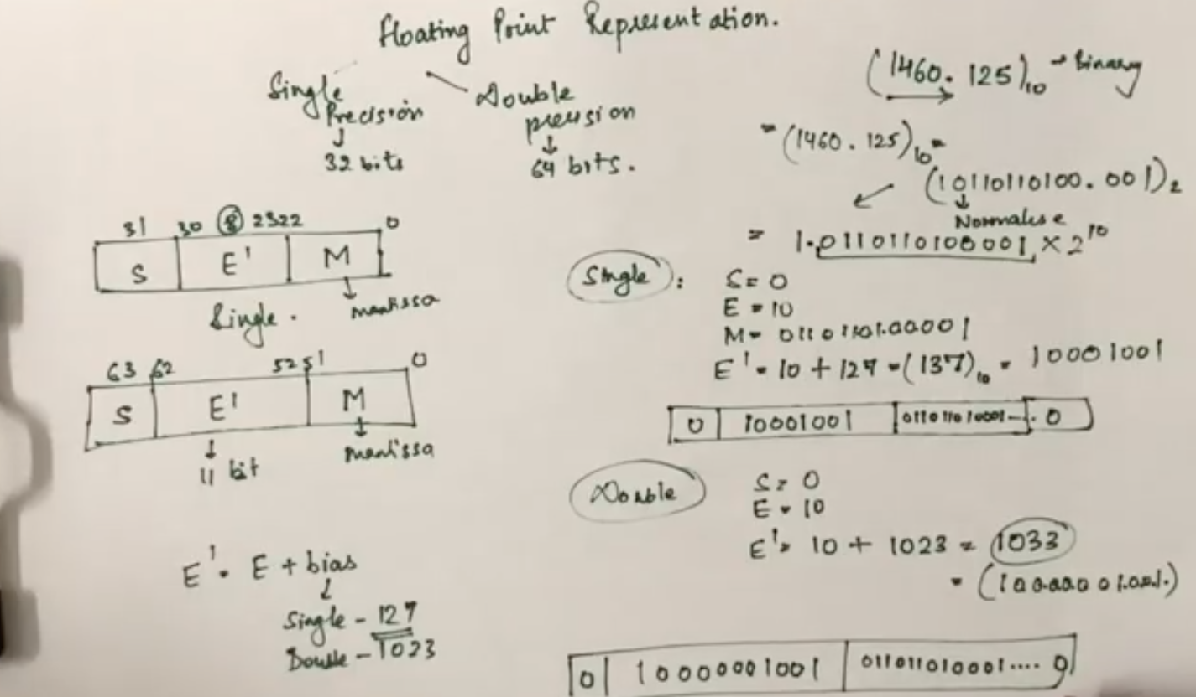
For Example...

Slide 14

Contd..
Fixed Point multiplier:
It is done using AND gate which is implemented by MUX and after that half adders are used for addition. And after that XOR gate is used for sign computation.
We have designed 2*2, 4*4, 8*8, 16*16 multiplier and 16*16 Multiplier and Accumulator and implemented them on ZEDBoard. The result are as follows:

Slide 15
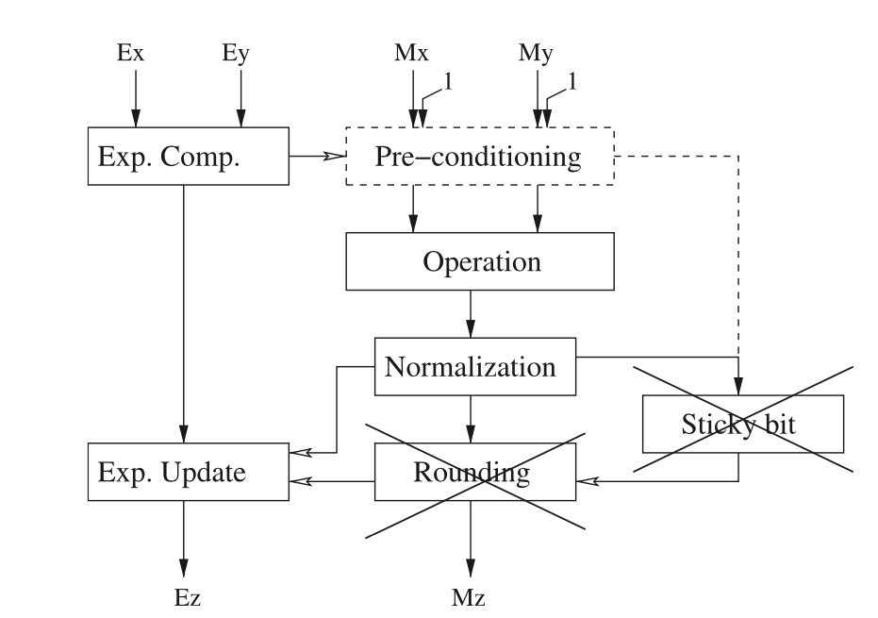
To perform a FP addition following steps are to be done:
Step 1 :
The mantissa parts of first FP number is multiplied with base raised to power of difference of exponents.
Step 2:
It is then added to significand of second number.
Step 3:
These are finally multiplied by base raised to power of exponent of second FP number.

Slide 16
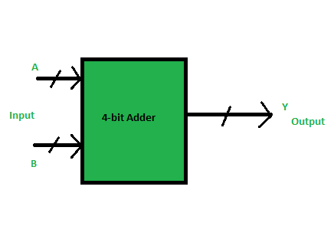
Binary Coded Decimal Adder
BCD adder is capable of adding two 4-bit words having a BCD format.
The result is a BCD-format 4-bit output word, representing the decimal sum of the addend and augend, and a carry that is generated if this sum exceeds a decimal value of 9.

Slide 17
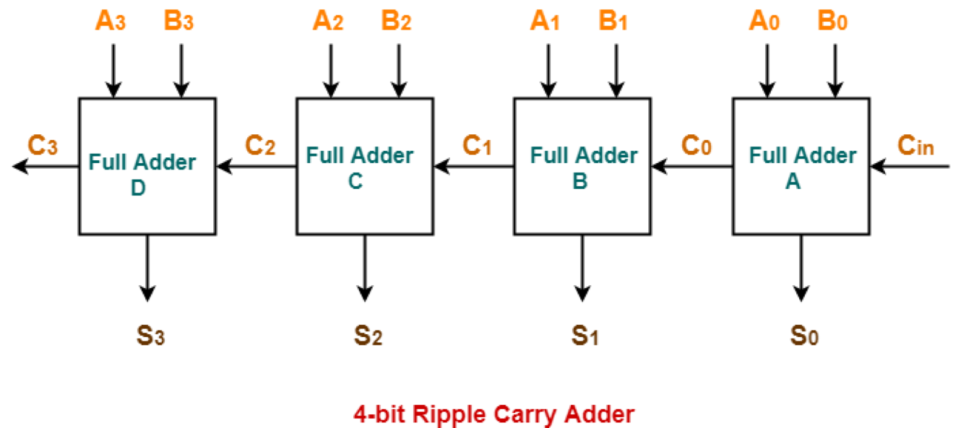
Ripple Carry Adder:
For a n bit ripple carry adder we require to connect n full adders in parallel.
It is based on the carry propagate algorithm.

Slide 18
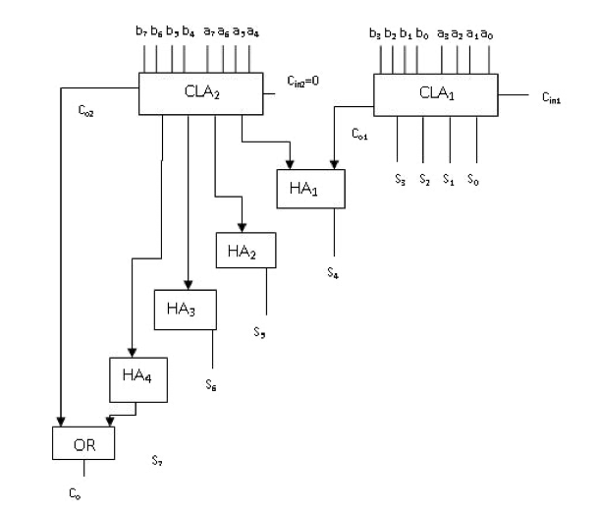
Carry Increment Adder:
Consists of Ripple carry adders and the incremental circuit.
The incremental circuits is designed using half adders in the ripple carry adder circuit.

Slide 19
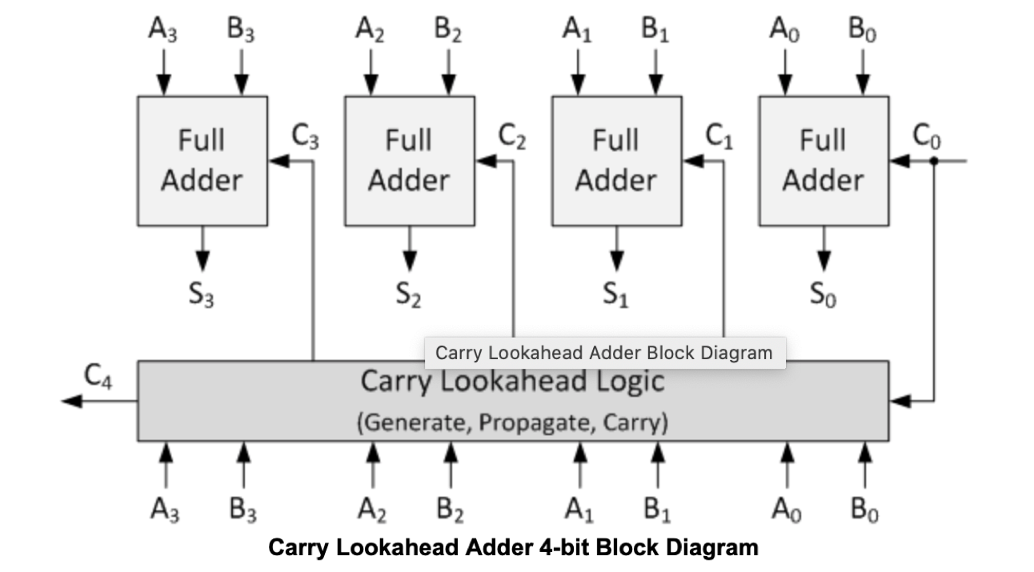
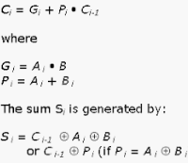
Carry Look Ahead Adder:
The difference between carry look ahead adder and ripple carry adder is it is able to compute the carry bit before the full adder operation is being done.
This provides it with an advantage in speed with comparison to the ripple carry adder.

Slide 20
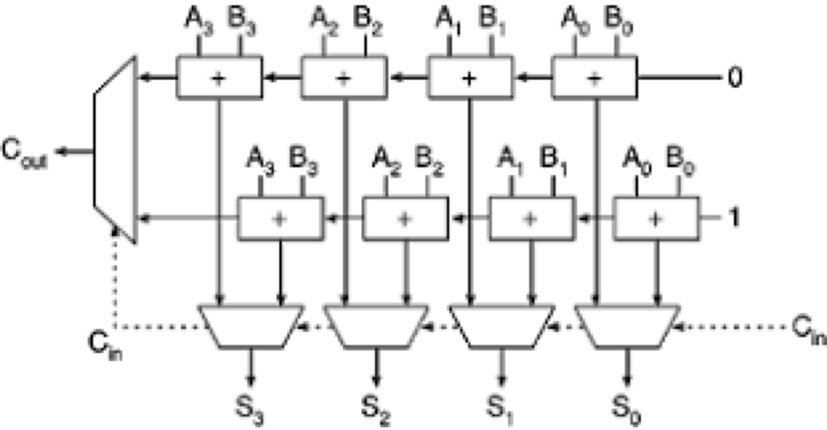
Carry Select Adder:
This is used for energy efficient design for reducing the area and power consumption.
In comparison with ripple carry adder it has shorter critical path and therefore lesser delay.

Slide 21
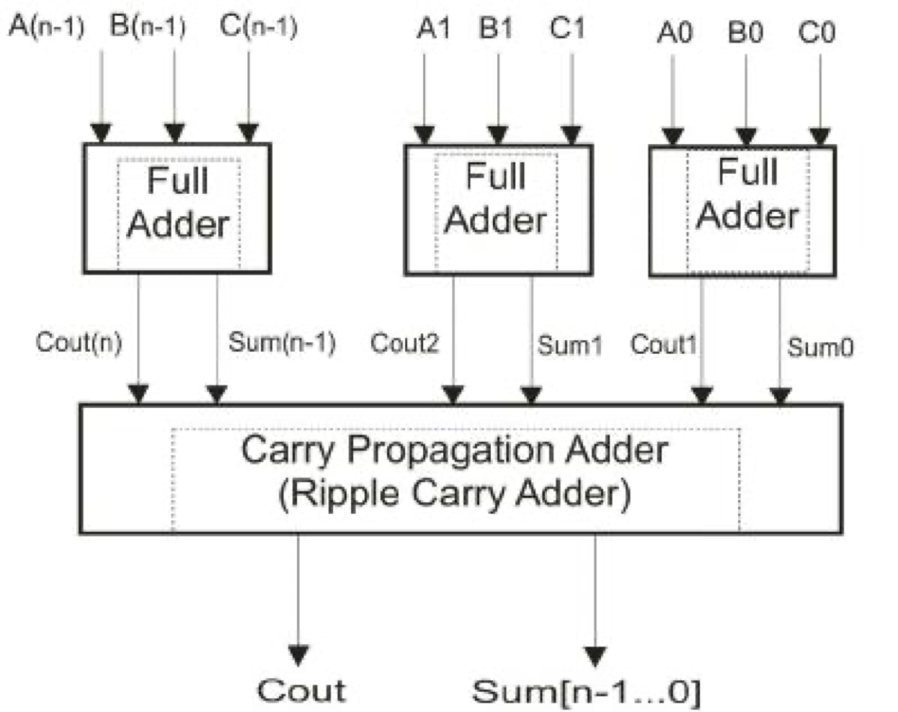
Carry Save Adder:
It differs from other adders in that it outputs two numbers of the same dimensions as the inputs, one which is a sequence of partial sum bits and another which is a sequence of carry bits.

Slide 22
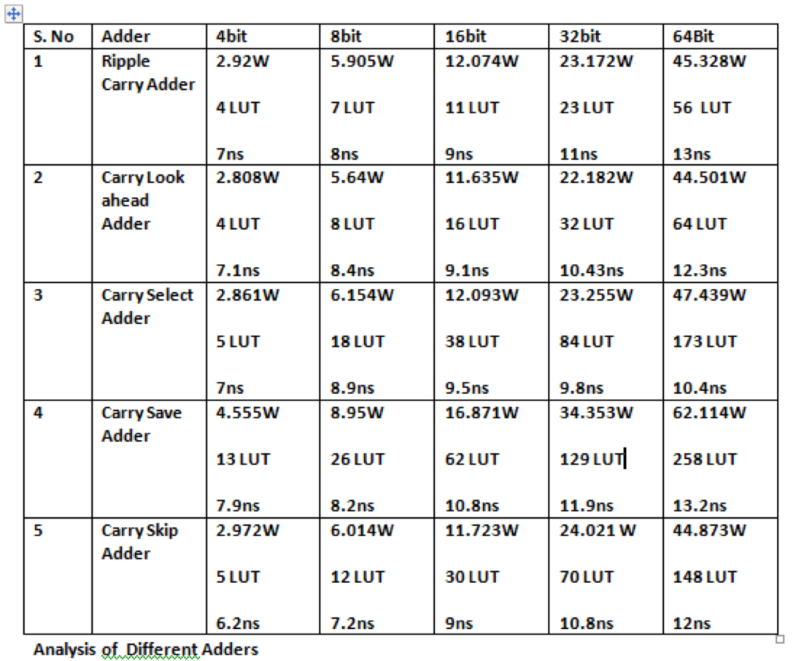
Power
Comparison

Slide 23
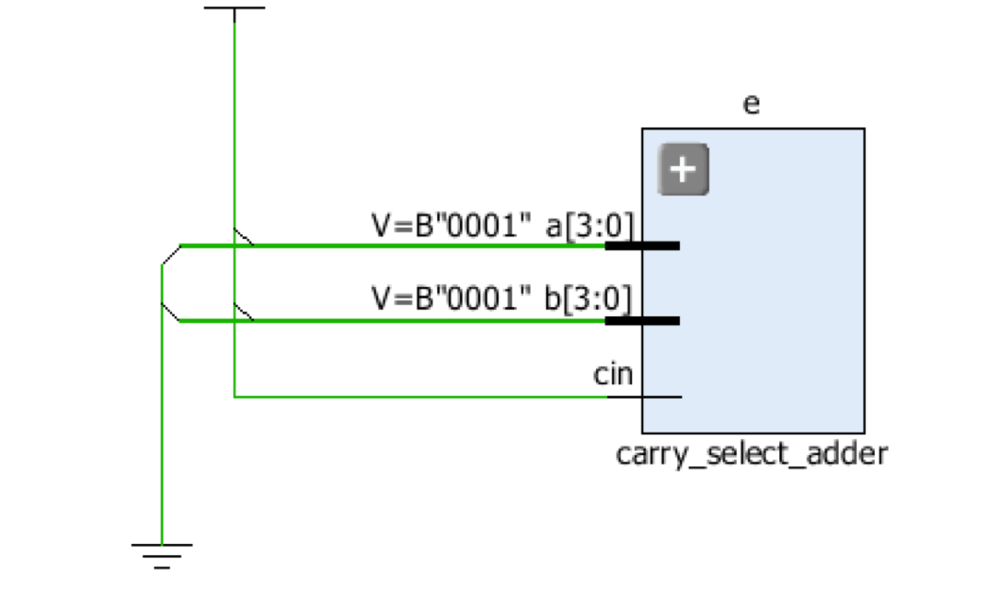
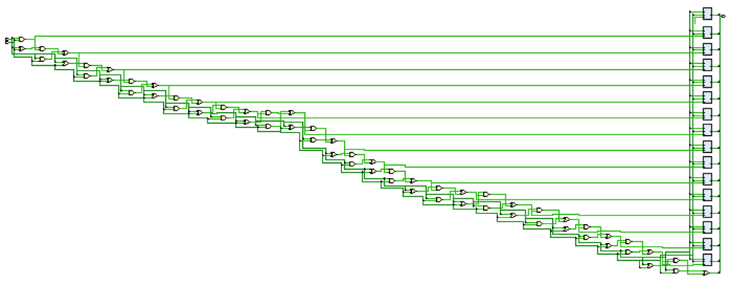
Elaborated Design
Carry Look ahead Adder
Carry Select Adder

Slide 24
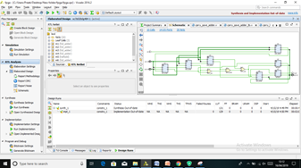
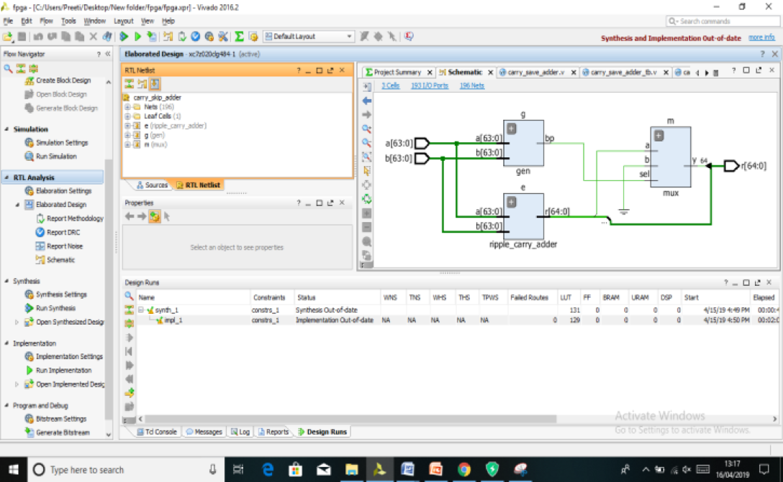
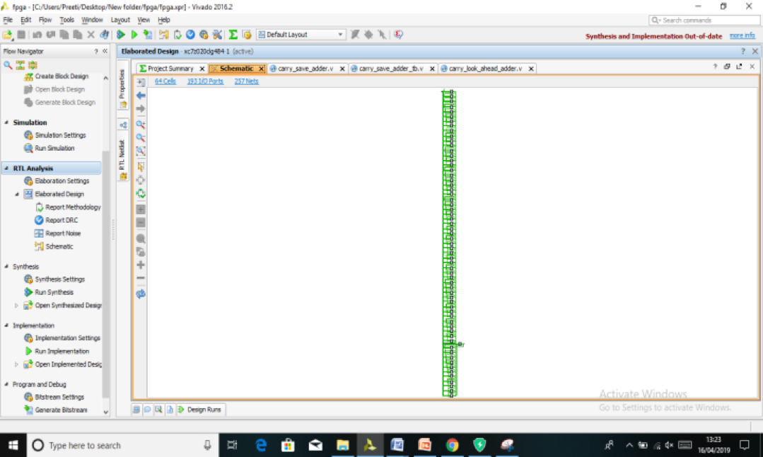
Elaborated Design
BCD
Carry Skip Adder
Ripple Carry Adder

Slide 25
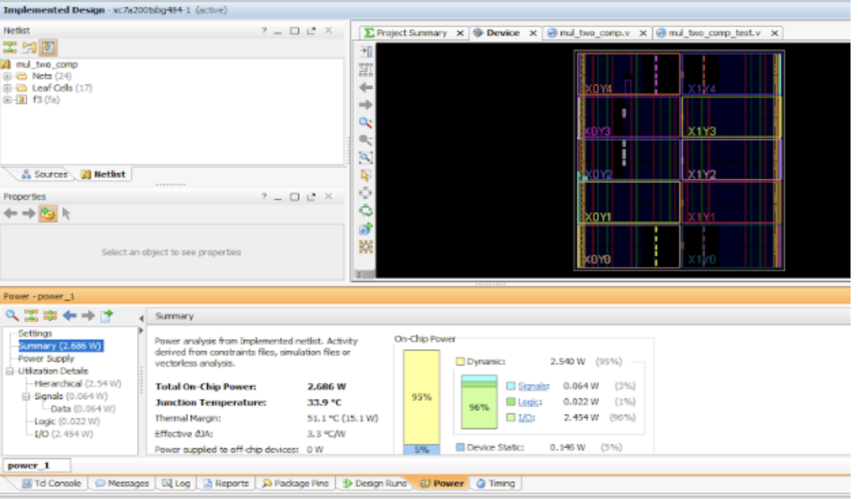
Power Consumption of fixed point multiplier

Slide 26
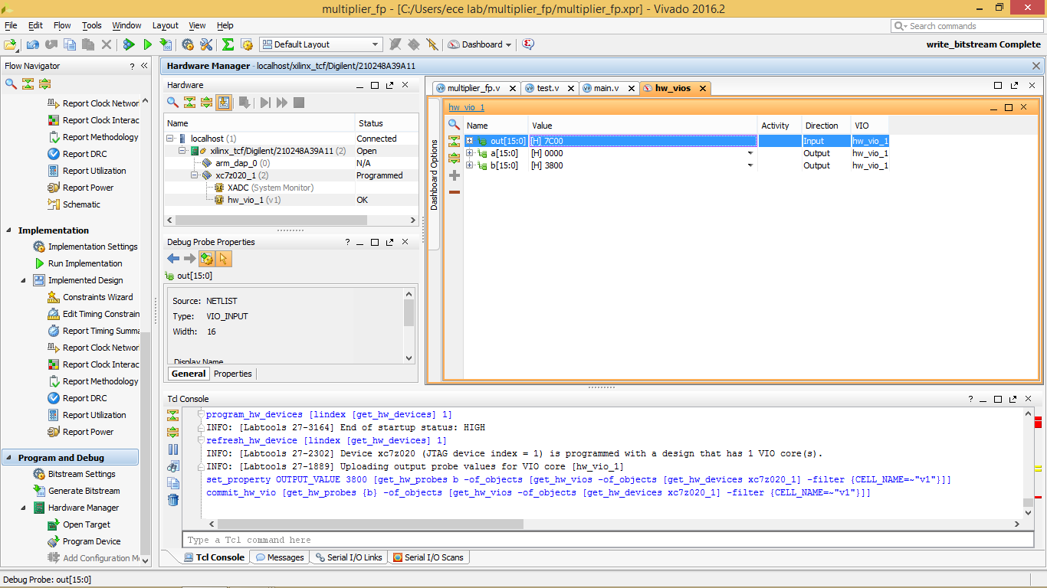
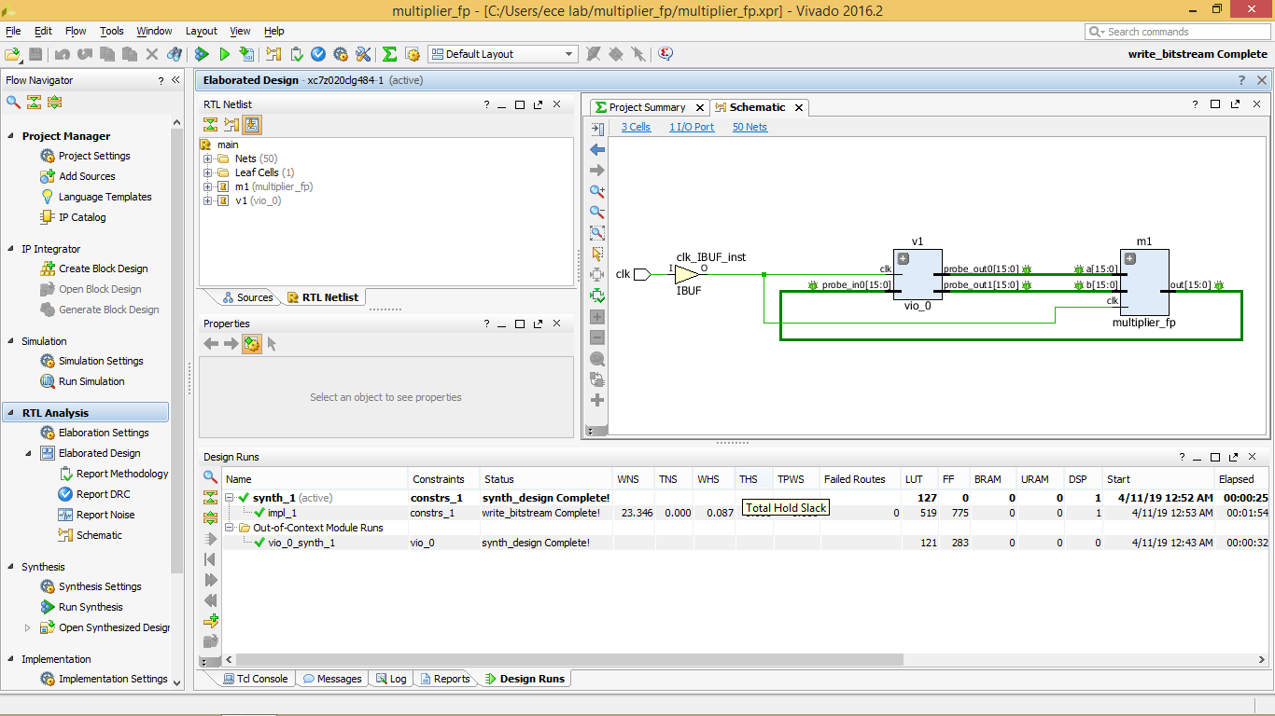
Floating Point Multiplier RTL Design

Slide 27
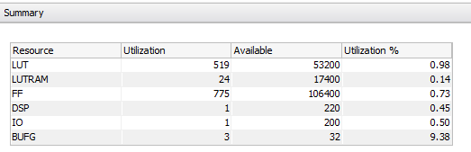
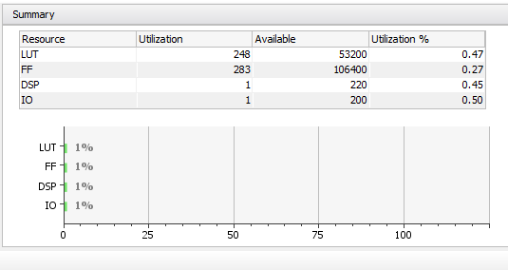

Analysis of FP Multiplier
Synthesis Report Utilisation
Implementation Report Utilisation

Slide 28
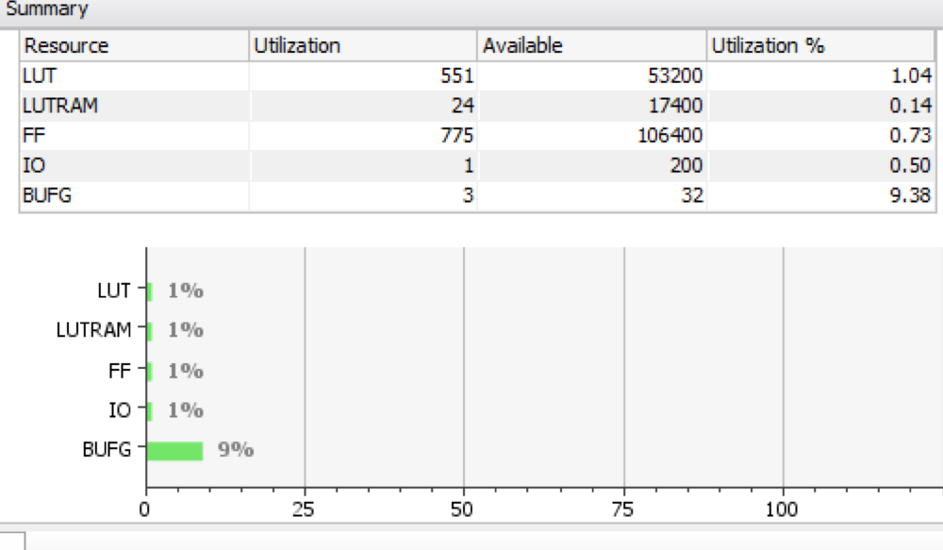
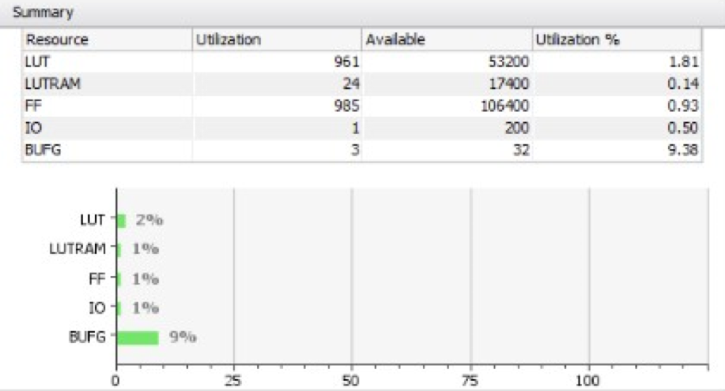
Analysis of FP Adder
Power Consumption of HUB 16 bit adder= 10.46W
Implementation Report Utilisation
Synthesis Report Utilisation

Slide 29
Power Comparison of Different Multipliers
SNo. | Power comparison of different multipliers
 | Multipliers | Power Consumption
1.) | 2x2 signed | 1.59W
2.) | 2x2 using two’s complement | 2.868W
3.) | 4x4 signed | 6.064W
4.) | 8x8 signed | 11.45W
5.) | 16x16 signed | 30.479W
6.) | 16x16 HUB multiplier | 23.46W

Slide 30




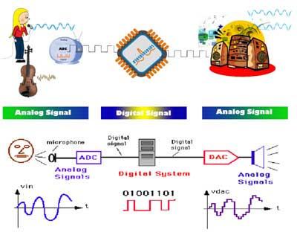
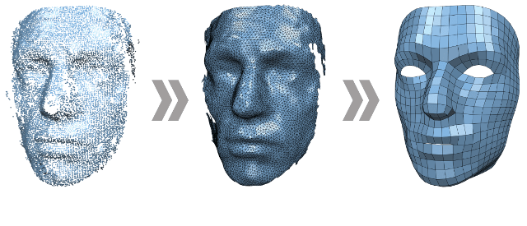

APPLICATIONS

Slide 31
References:
[1] C.R. Baugh and B.A. Wooley, “A Two’s Complement Parallel Array Multiplication Algorithm,” IEEE Trans. Computers, vol. 22, no. 12, pp. 1045-1047, Dec. 1973.
[2] Javier Hormigo and Julio Villalba,”HUB Floating Point for Improving FPGA Implementations of DSP Applications”, IEEE TRANSACTIONS ON CIRCUITS AND SYSTEMS,, VOL. 64, NO. 3, MARCH 2017
[3]Tarun Vatwani, Arko Dutt, Debjyoti Bhatacharjee , Anupam Chattopadhyay, “Floating Point Multiplication Mapping on ReRAM based In memory Computing Architecture,” 2018 31st International Conference on VLSI Design and 2018 17th International Conference on Embedded Systems (VLSID).
[4] Jiun-ping Wang ; Shiann-rong Kuang ; Yuan-chih Chuang “Design of Reconfigurable Low-Power Pipelined Array Multiplier” 2006 International Conference on Communications, Circuits and Systems.

Slide 32


